Slide 1
The Black roots of Latin music

Slide 2
Is There a Future for Latin Trap Music? An essay by Gloria Malone
Gloria Malone es una escritora y consultora que colabora para varias revistas en Estados Unidos. Mayormente escribe sobre acontecimientos sociales de relevancia, la importancia de la cultura y las estructuras sociales y raciopolíticas.

Slide 3
Su tarea (your task)
First, we are going to divide the class into seven groups.
Each group will read a different excerpt of Gloria Malone’s essay on the Black origins of Latin music.
As a group, your task is to answer the questions on your group’s handout together. When you’re done, your group will report a summary of the excerpt that you read to the class.
I will give you ten minutes to complete your group work; then we’ll all report to the class.
Any questions? ☺

Slide 4
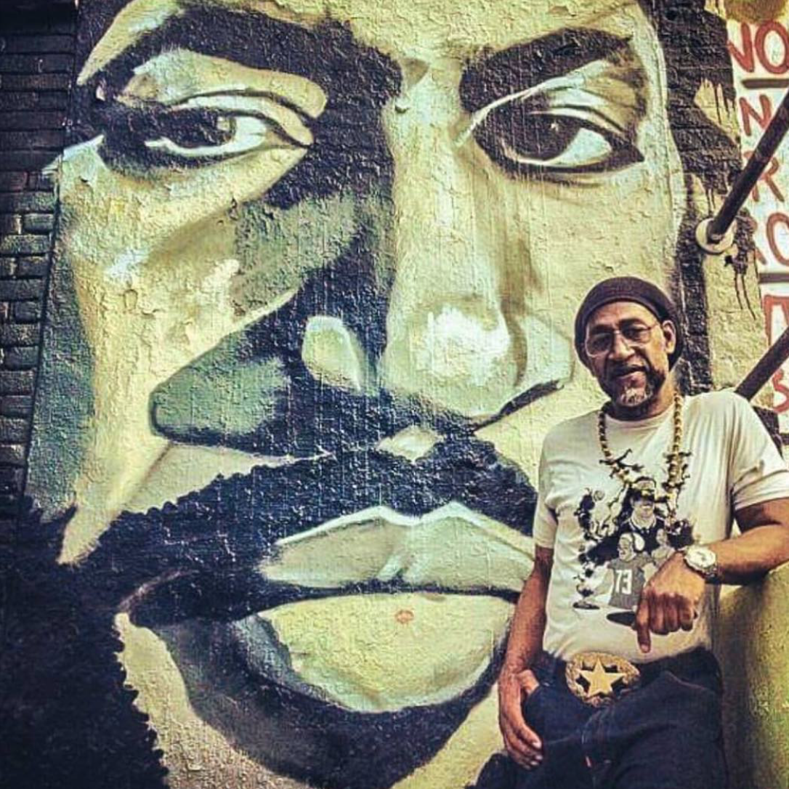
Este es DJ Kool Herc, el fundador del hip hop
Notes:
Show during group 2 – this is DJ Kool Herc, founder of HipHop)

Slide 5
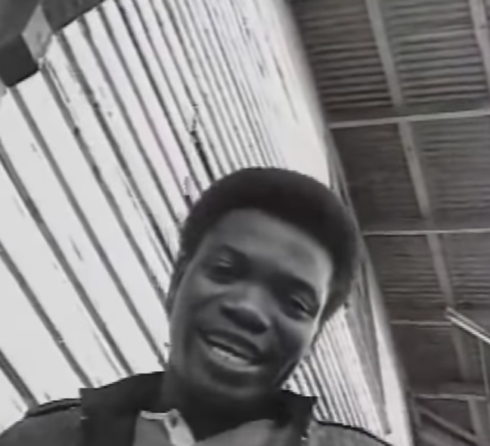
Leonardo ‘Renato’ Aulder, panameño Es mi chica de los ojos café
https://youtu.be/iNx1NTxI6tU
You can feel the beats of reggae but also feel his Spanish language to sing it. This was what led the way to reggae en español, and then reggaeton, being born.
Notes:
Play after group 4 presents– this shows Renato singing. You can feel the beats of reggae but also feel his Spanish language to sing it.) This was what led the way to reggae en español, and then reggaeton, being born.

Slide 6
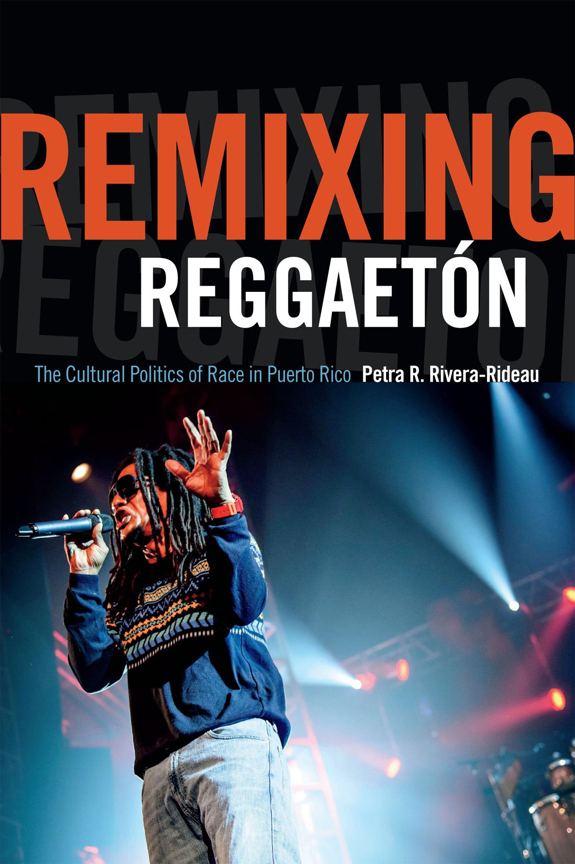
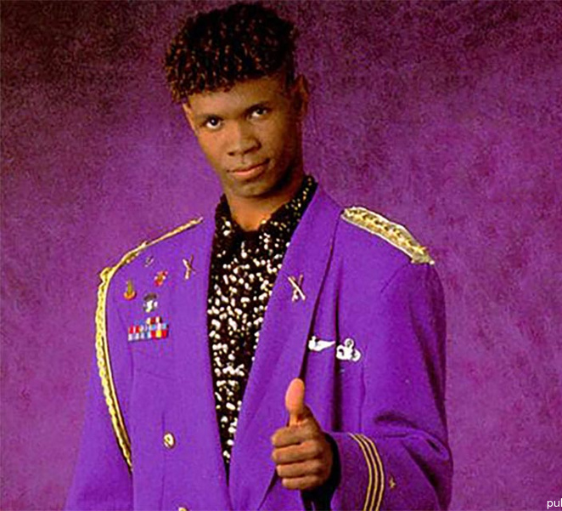
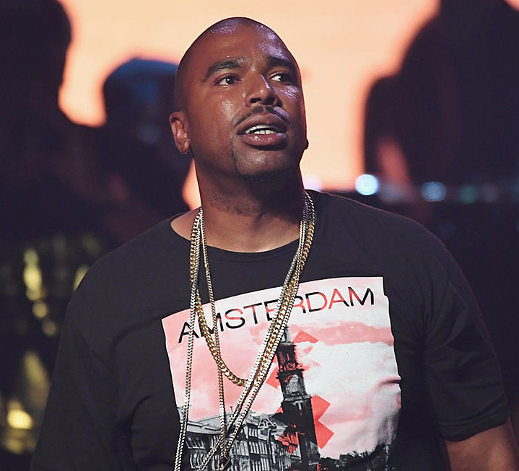
Dr. Petra Rivera-Rideau
Tego Calderón
“One of the things that makes reggaetón interesting to me is how it provokes such extreme responses. There are whole internet sites, for example, dedicated to hating reggaetón. But beyond that, I think that, at least in Puerto Rico, part of the attention reggaetón has received from legislators and policy makers is not really about the music itself as much as it is about underlying anxieties about race, especially Blackness, and class issues … Reggaetón is, of course, party music. But it also brought to the fore issues like racial discrimination and problems facing poor urban communities on the island in ways that really challenged a lot of the dominant narratives about … what being Puerto Rican means.”
Source: https://remezcla.com/features/music/new-book-remixing-reggaeton-racial-politics/
El General
N.O.R.E.
Notes:
Show after Group 6. Have a student volunteer read Dr. Rivera-Rideau’s quote. Then drop a mic.
Note - In PR there were actually police RAIDS against stores that sold reggaeton music!

Slide 7
La Gata
https://youtu.be/iTY6G0gYAQw
Notes:
Show after group 7 reports on their task outcome -- play video only until 1:11 minutes.

Slide 8
Group Discussion
We just summarized together Malone’s essay. We can see the Black roots of Latin music, and also, the history of reggaeton and of trap music.
What is reggaeton? Where did it come from?
What is Latin trap music?
What does Malone argue needs to happen to Latin trap in order for it to be seen and honored as it should be?
What do you all think about music as a space to raise awareness?
Why do you think Malone wrote this essay? What was she responding to?

